Slide 1



Transparency
Work is created as a combined effort of:
Oleksii Avdieiev 191ADB057
Rustam Adilov 191ADB071
Shokhzhakhon Tursumamatov 191AIB143
Aakarsh Grandhi 191ADB108
Eldor Rakhmonaliev 191ADB052
Fatima Karimova 201ADB002
Sándor Burian 220ADM028
Kanan Sharifov 191ADB053
Ali Zikry 191ADB065

Slide 2
What is “Transparency”?
“Transparency” is an experimental messenger that breaks the conventions of messengers by eliminating the idea of privacy.
“Transparency” is meant to be an example of what would happen if everyone could access anyone’s personal messages.
It explores the idea of trust and accountability.
The idea is niche and is not considered a substitute for messengers.

Slide 3
Features
“Transparency” features full access to all messages of any user to all other users.
The login system is extremely important in “Transparency”, therefore to login the special key is supplied to any user during the registration.
One of the important features to mention is that only people that have mutually agreed to chat, will be able to write each other messages.
One of the entertaining features of the app is the Featured tab which contains different categories of chats which may be interesting to people (this tab learns user preferences to provide better entertainment).
The “Transparency” is a very sincere app, therefore it is impossible to delete something, unless it is legally needed.

Slide 4
Non-functional requirements
Access key consists of 32 randomly chosen UTF-8 symbols (such passwords are needed to strengthen the security of accounts, otherwise people using the app can be easily compromised).
Servers should allow up to 100000 active users, this number is scalable and depends on the number of registered users.
Messages should be delivered in a span of 1 second.
The messenger should be available on all relevant iOS and Android systems, as well as on macOS and Windows.
Only email is enough to register an account, no other personal data is needed.

Slide 5
Tools and methodology
Following tools are going to be used for the development:
Github
JetBrains IDEs
Android Studio
Flutter (Android and IOS)
C# (Windows)
Objective C (MacOS)
The RAD methodology is going to be used for Project Management (more about it during the Software Models segment)

Slide 6
Creator user persona
User’s Persona Parameters
User Persona | Environment | Tasks
Ages: 20-60 Gender: not important. Occupation: influencers, politicians, businessmen. Goal and tasks: earn followers and trust, and build the image. Motivation: it could earn money for businesses and influencers and raise ratings for politicians. Fears: the possibility of failure, to expose private data that should not be exposed. Expectations: usage of the software to build social image and trust of society. | Context of usage: regular updates, or when needed, the location of usage is unimportant as the soft is available on mobile. | Tasks: chat with colleagues and partners, perform interviews and publish data that is publically available; perform interesting entertainment activities using the possibilities of the chat.

Slide 7
Consumer user persona
User’s Persona Parameters
User Persona | Environment | Tasks
Ages: all ages. Gender: not important. Occupation: all occupations. Goal and tasks: get information and entertainment from the messenger. Motivation: dopamine and erudition. Fears: accidental exposure of unwanted information. Expectations: usage of the software to get information or entertainment. | Context of usage: used in free time for information consumption or for chatting with relatives and friends as an experiment. | Tasks: access the chats of influencers; get information about business and political affairs; access group chats of companies; chat with family or friends, or even strangers.

Slide 8
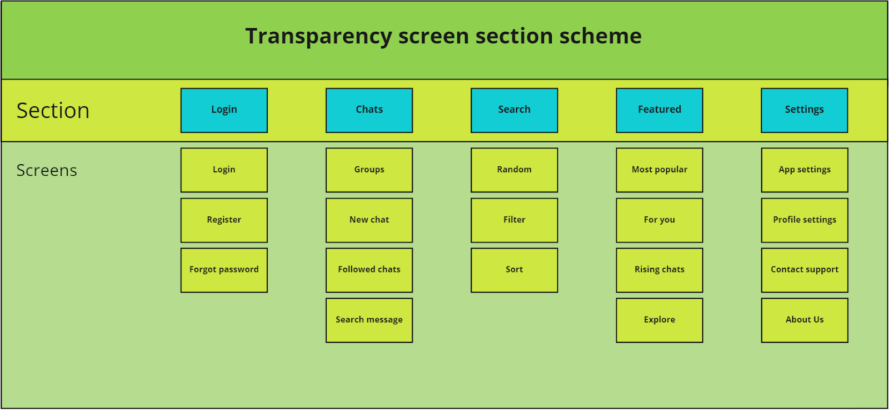
Screen section scheme

Slide 9
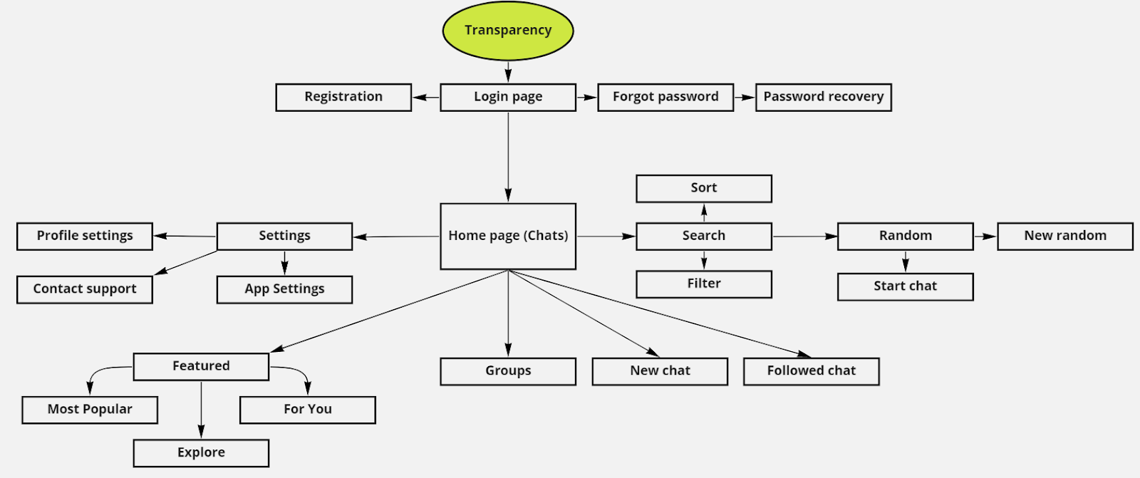
User behavior diagram

Slide 10
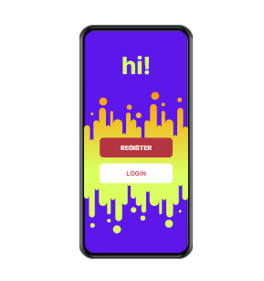
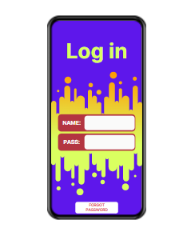
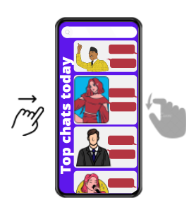
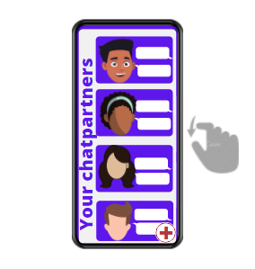
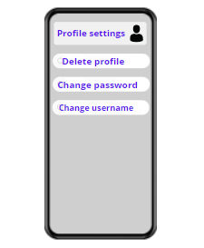
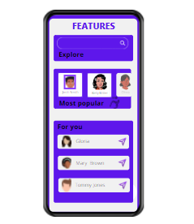
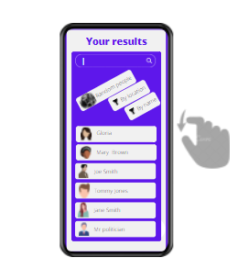
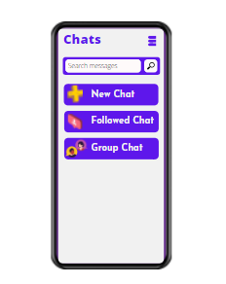
Wireframe

Slide 11
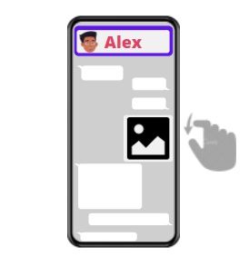
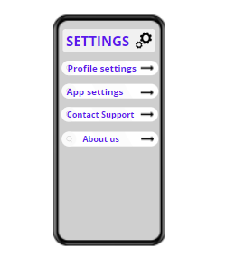
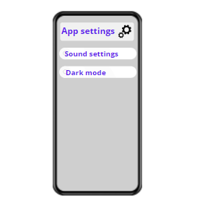
Wireframe

Slide 12
Individual presentations segment

Slide 13
Data Modeling
In Transparency app, by: Ali Mohamed Ayman Riad Ahmed Zikry / 191ADB065

Slide 14
Definition
The process of structuring and organizing data is known as Data Modeling. After structuring of data, it is implemented in the database system. While organizing data, certain constraints and limitations are also applied to data. The main function of Data Modeling is to manage a large amount of both structured and unstructured data. In data modeling, initially, a conceptual data model is created which is later translated to the physical data model. Present nowadays topics and solutions that are used in this topic field.

Slide 15
Challenges #1
Ensuring data quality
Data quality and the amount of effort required to address data quality issues are usually the biggest challenges in this area as the traditional process to deal with data quality involves a lot of hard-coded business logic, which makes the data pipeline very difficult to maintain and to scale.

Slide 16
Challenges #2
Identifying contributors to dirty data
If the data at the source is not accurate, everything in the rest of the data modeling process that's based on that data will crumble.
Data inaccuracy could occur during the creation and acquisition of data, during the cleaning process or even when annotating data.

Slide 17
Challenges #3
Enabling fitness for purpose
Fitness for purpose means the data is correct and trustworthy for its intended uses according to the rules that govern it.
The real difficulty is that correct and trustworthy are very contextual. They vary [based] on the data and how it's being used.

Slide 18
Challenges #4
Breaking down data silos
Another challenge to the data modeling process is siloed systems, which often run on legacy architectures and undermine the effectiveness of predictive analytics tools. In addition, newer data sources, such as third-party apps, premium data sources, and self-service BI and machine learning curated data sets, are growing in importance.
Privacy regulations also create new obstacles to bringing these data silos together efficiently.

Slide 19
Challenge #5
Avoiding the Las Vegas effect
Analytics users can also inadvertently create new data silos in the cloud when they use SaaS-specific analytics platforms like Salesforce Einstein to curate and model data sets outside of centralized data engineering efforts. Organizations need to strike a balance between the benefits of ad hoc analytics on these platforms and making it easier to adopt centralized data management practices.

Slide 20
Challenges #6
Starting fresh or cleaning old data
Enterprises need to confront a sunken cost bias when deciding on a curation and data modeling process. Many enterprises have assembled massive stores of data without figuring out how they fit into the business process.
There is always a tradeoff between taking in more data and cleaning the data we already have.

Slide 21
Challenges #7
Understanding what the business cares about
The biggest challenge to data curation and modeling remains the same: Does the business care? If a business cannot see the value of data, then it will have no motivation to curate it.
Excel remains the No. 1 BI tool in most organizations, which is a fundamental demonstration that quality is secondary to immediacy, Curation needs to add value to the data modeling process.
What is bad data for one person could be good data for another, For instance, bad sales data from a customer accuracy perspective is clearly bad for sales. But this same data might be ideal for implementing AI to identify challenges in the current sales process.

Slide 22
UML (Unified Modeling Language)
Rustam Adilov 191ADB071

Slide 23

Table of content
1. What is UML?
2. UML version 2 and 2.5?
3. What are UML Diagrams?
4. Most relevant UML diagrams these days
5. Tools/Software solutions used in UML

Slide 24
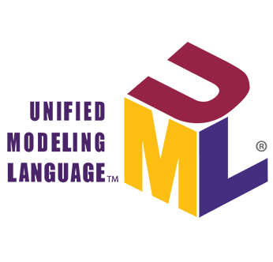
UML or Unified Modeling Language
UML ( or Unified Modeling Language) is a notation that can be used for object-oriented analysis and design. It can be used to visualize, specify, construct, and document software systems. Put simply, UML is a modeling language in a field of object-oriented software engineering
The standard is managed, and was created, by the Object Management Group (OMG)

Slide 25
UML version 2 and 2.5
UML 2.0 (and later version 2.5) was a major upgrade to a version a UML 1.x. It was developed with an enlarged consortium to improve the language further to reflect new experience on usage of its features. Summary of new integrated features: 1. Nested Classifiers 2. Behavioral Modeling improvement 3. Improvement in relationship between Structural and Behavioral Models.
That is, the new language goes well beyond the Classes and Objects well-modeled by UML 1.X to add the capability to represent not only behavioral models, but also architectural models, business process and rules, and other models used in many different parts of computing and even non-computing disciplines.

Slide 26
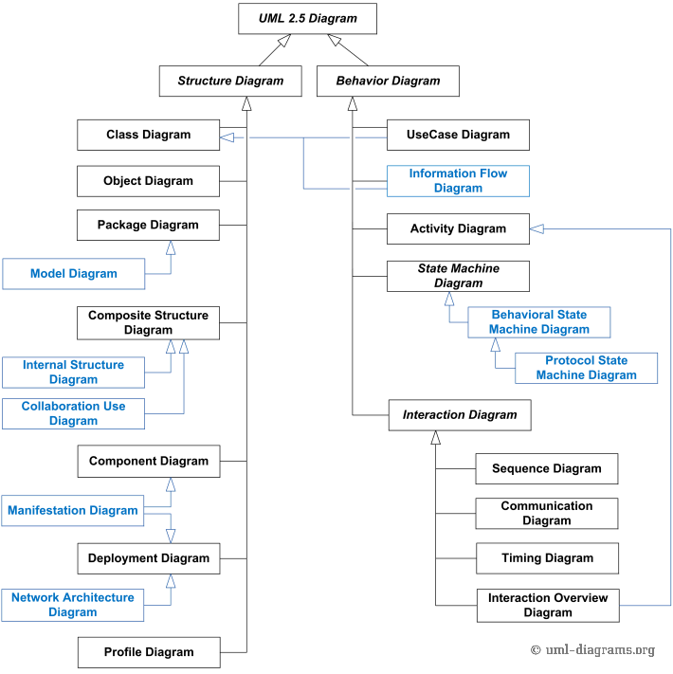
UML Diagrams
With UML 2.0 There is four more new diagrams, bringing total from 9 to 13 (and plus 1 with UML 2.5)
UML Diagrams are divided into 3 categories: Structure Diagrams, Behavior Diagrams and Interaction Diagrams. Other sources tell it is divided into 2 categories but not 3.
This chart to the left describes all 14 UML Diagrams divided into 2 categories.

Slide 27
Most relevant UML Diagrams to these days
Class Diagrams and Sequence diagrams are the most popular UML diagrams to these days, followed by Use Case and State diagrams
They can easily be used on white boards to elaborate and discuss design before jumping in the code
They allow to convey very quickly an overview which the code alone doesn't give so easily, and there's no viable substitute to it.
They help with documenting relations between classes and describe the boundaries of system.

Slide 28
Tools and Software Solutions
Examples of widely used UML tools:
Lucidchart
Diagrams.net
Umodel
Microsoft Visual Studio
And so on...
You can find all the UML development tools in this website https://www.omg.org/uml-directory/
Most of these software solutions support UML 2.0 and 2.5 and provide some unique benefits

Slide 29

References
Decker, K. (2016). Uml Distilled A Brief Guide To The Standard Object Modeling Language.
Visual Modeling: past, present and future by Andrew Watson, OMG
Introduction to OMG UML by Dr. Jon Siegel, OMG
Muruga, D.B.Naga. (2019). Basics of UML. 10.13140/RG.2.2.16202.72646.
Software Engineering Stack Exchange, 2017 DYZ
Reggio, G., Leotta, M., Ricca, F., & Clerissi, D. (2013). What are the used UML diagrams? A Preliminary Survey. EESSMod@MoDELS.
UML 2.5.1 Specification, formal, OMG, 2017

Slide 30
Software Development Models
Oleksii Avdieiev
191ADB057
02.06.2022

Slide 31
What are Software Development Models?
Software development models are used to structure the process of software development by providing a number of steps that must be performed to reach the aims and goals of the project.
Software development models follow the software development life cycle but incorporate its phases into different stages. The number of times a stage occurs, as well as its sequence in the model may differ.
Thus, each model is more suitable for some projects, while being less suitable for others. The choice depends on goal, scale and resources allocated for the projects.

Slide 32
Traditional Software Development Models
Following models are considered traditional and have been in use since 20th century:
Waterfall,
V-model,
Iterative,
Spiral,
Rapid application development (RAD).

Slide 33
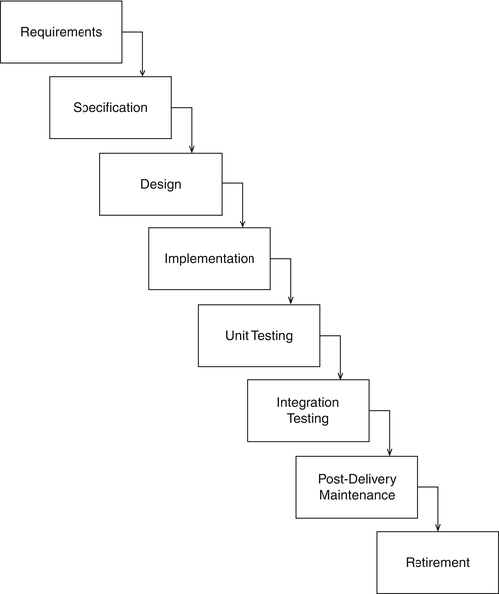
Waterfall
(adopted from (Sherrell, L. (2013) ))

Slide 34
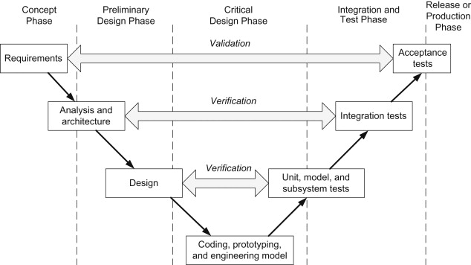
V-model
(adopted from (Bertino and Crampton, 2008))

Slide 35
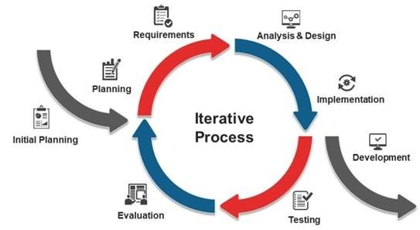
Iterative
(adopted from (Miraz and Ali, 2020))

Slide 36
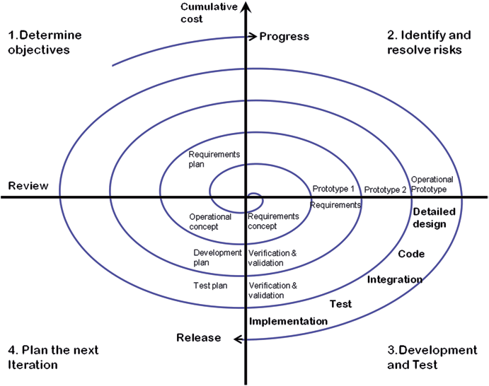
Spiral
(adopted from (Cowley, 2014))

Slide 37
Agile
Agile methodologies are flexible and follow 12 principles, which, encompass (Beck, K., et al., 2001):
flexible change of requirements,
constant delivery,
maintain motivation,
simplicity,
self-organization.
Agile methodologies include:
SCRUM
Extreme programming

Slide 38
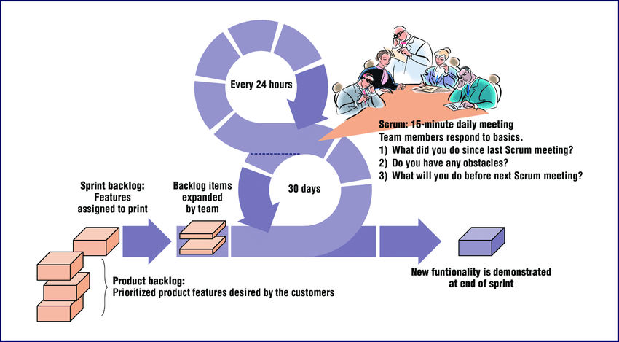
SCRUM
(adopted from (Boehm and Turner, 2005))

Slide 39
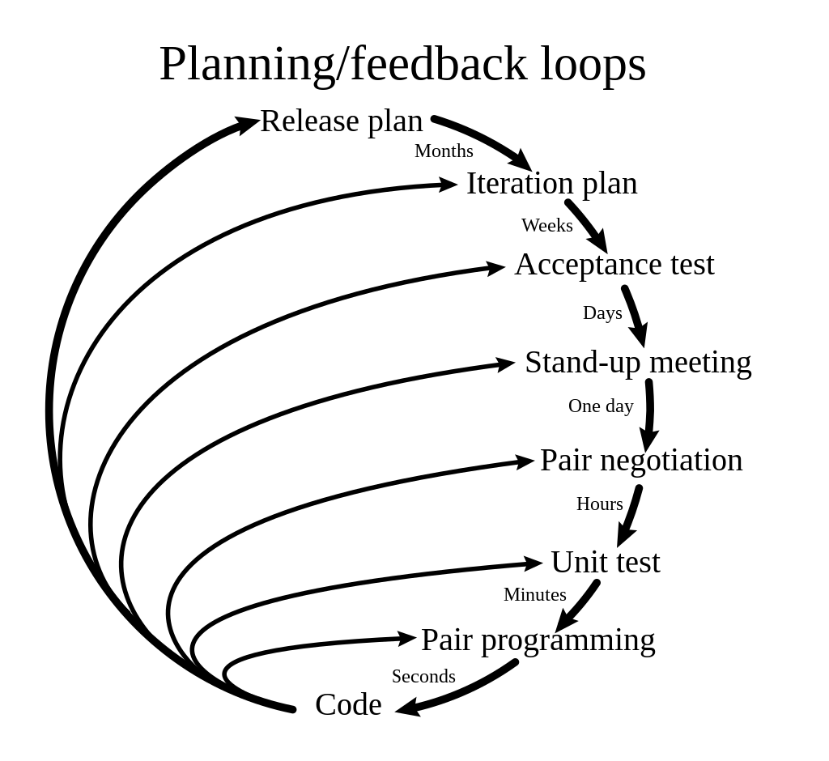
Extreme Programming
(adopted from (https://en.wikiquote.org/wiki/Extreme_programming))

Slide 40
RAD
For the development of Transparency messenger, the RAD methodology will be used.
The reasons are:
Compared to other development process methodologies it has better quality, good risk control.
The entire process is compressed and thus the new system is built and tested much sooner.
This method is more suitable for smaller developer teams.

Slide 41
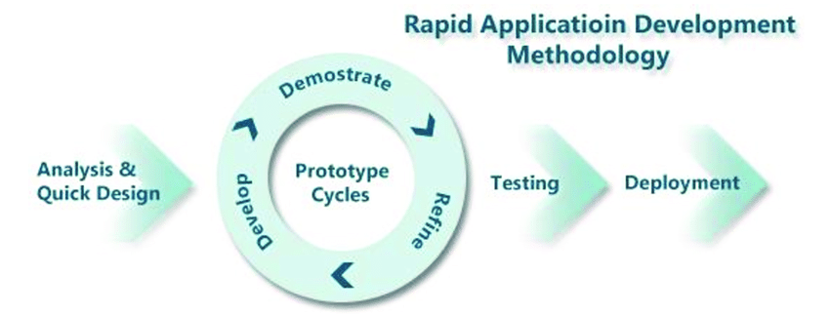
RAD
(adopted from ((Abd Ghadas et al., 2015))

Slide 42
References
Beck, K., et al. (2001) The Agile Manifesto. Agile Alliance. http://agilemanifesto.org/
Subbarayudu, B. et al. (2017) ‘Review and comparison on software process models’, International Journal of Mechanical Engineering and Technology, 8, pp. 967–980.
Sherrell, L. (2013) ‘Waterfall Model’, in Runehov, A.L.C. and Oviedo, L. (eds) Encyclopedia of Sciences and Religions. Dordrecht: Springer Netherlands, pp. 2343–2344. doi:10.1007/978-1-4020-8265-8_200285.
Bertino, E. and Crampton, J. (2008) ‘Security for Distributed Systems: Foundations of Access Control’, in Information Assurance. Elsevier, pp. 39–79. doi:10.1016/B978-012373566-9.50005-7.
Miraz, D. and Ali, M. (2020) ‘Blockchain Enabled Smart Contract Based Applications: Deficiencies with the Software Development Life Cycle Models’, Baltica, 33, pp. 101–116.
Cowley, B. (2014) ‘The QUARTIC Process Model for Developing Serious Games: “Green My Place” Case Study’, in Lee, N. (ed.) Digital Da Vinci. New York, NY: Springer New York, pp. 143–172. doi:10.1007/978-1-4939-0965-0_8.
Boehm, B. and Turner, R. (2005) ‘Management Challenges to Implementing Agile Processes in Traditional Development Organizations’, IEEE Software, 22(5), pp. 30–39. doi:10.1109/MS.2005.129.
Abd Ghadas, Z. et al. (2015) ‘LAFAMS: Account management system for Malaysian small legal firms’, 23, pp. 239–250.

Slide 43
The ontology of „Transparency” App
The ontology of „Transparency” App
Applied System Software(English)(1),21/22-P - Sándor Burian | 220ADM028
Final Step 3 – Ontology

Slide 44
What is an ontology?
„An ontology encompasses a representation, formal naming, and definition of the categories, properties, and relations between the concepts, data, and entities that substantiate one, many, or all domains of discourse”
„The software engineering ontology defines common sharable software engineering knowledge including particular project information. Reaching a consensus of understanding is of benefit in a distributed multi-site software development environment” „Core ideas and objectives of ontology engineering are also central in conceptual modelling”

Slide 45
Phases of ontology
Design
Implementation
Integration
Maintenence
Retirement

Slide 46
Ontology types
Static
Dynamic
Intentional
Social

Slide 47
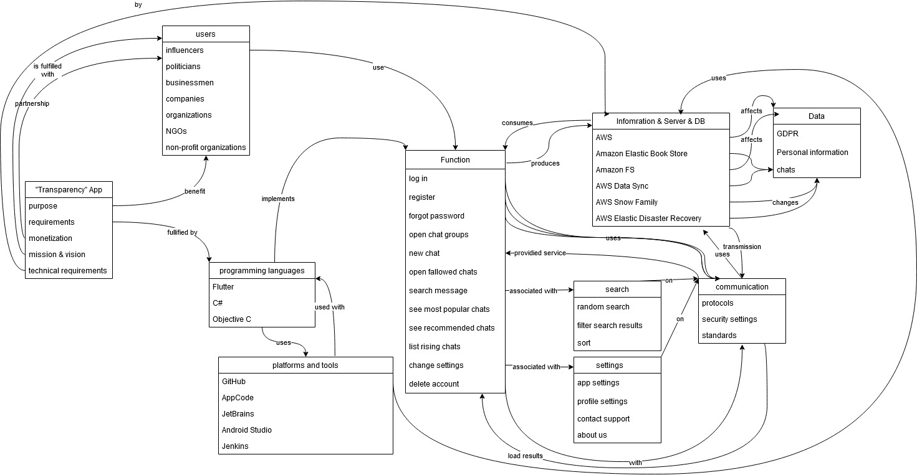
Ontology of Transparency app

Slide 48
Bibliography
Gasevic, D., Kaviani, N., & Milanović, M. (2009). Ontologies and Software Engineering (pp. 593–615). https://doi.org/10.1007/978-3-540-92673-3_27
Ontology engineering. (2022). In Wikipedia. https://en.wikipedia.org/w/index.php?title=Ontology_engineering&oldid=1090103162
Ontology (information science). (2022). In Wikipedia. https://en.wikipedia.org/w/index.php?title=Ontology_(information_science)&oldid=1085831526
Piattini, M., Calero, C., & Ruiz, F. (2006). Ontologies for Software Engineering and Software Technology. https://doi.org/10.1007/3-540-34518-3_4
Wongthongtham P, Chang E, Dillon T, & Sommerville I. (2007). Software Engineering Ontology – the Instance Knowledge (Part I). 7. https://espace.curtin.edu.au/bitstream/handle/20.500.11937/7780/20390_downloaded_stream_378.pdf?sequence=2&isAllowed=y

Slide 49
Software quality
Eldor Rakhmonaliev – 191ADB052

Slide 50
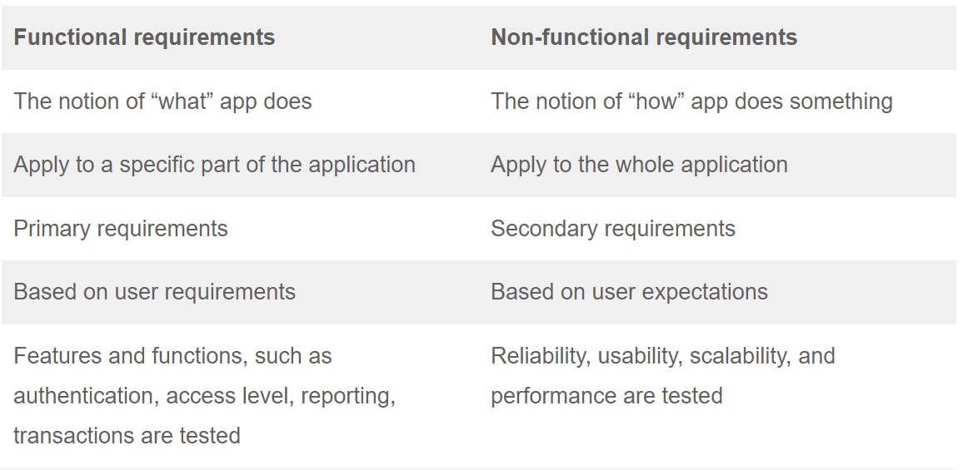
What is Software quality
Quality assurance (QA) engineers can't rely on their own judgments about a product's quality. The QA specialists must be able to apply particular criteria to verify that the quality requirements are being met.To create high-quality software, you must construct it in such a manner that it performs as intended. An application's functionality and nonfunctional requirements are scrutinized by software quality engineers in order to ensure that it meets these standards.

Slide 51
FUNCTIONAL AND NON FUNCTIONAL REQUIREMENTS
The behavior and output of the system (the system's behavior and reaction) are important considerations in software development.Project-specific functional needs are more likely to be project-specific, rather than system-wide. As a rule of thumb, functional requirements specify features and functions such as user authentication and access level as well as reporting, transactions, and so on.
Non-functional requirements are those that are not specific to a single feature of the product. Rather than being a set of laws to be followed, they are considered as a collection of "best practices" rather than specific directives. Non-functional requirements assist to go above and beyond the essentials and meet or exceed the expectations of the customer, while functional requirements ensure that the application does what it is supposed to do. In economic terminology, "added product value" refers to the characteristics of a product.

Slide 52
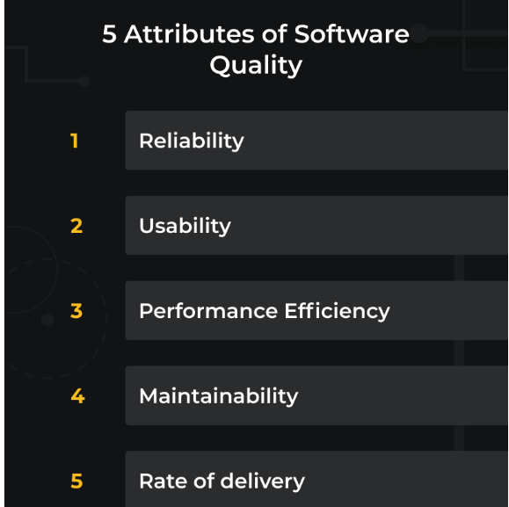
MEASURING THE SOFTWARE QUALITY
It's interesting to note that quality isn't a yes-or-no issue, but rather one of extent.

Slide 53
RELIABILITY:
Under what circumstances does your app work best? If you don't know the answer to this question, you may not know how reliable your app is. For example, a product upgrade or server move might cause an app's reliability to be compromised.
USABILITY:
Focus groups are often used to do usability testing, which entails interviewing a representative sample of the intended audience. Users are expected to accomplish a variety of activities in a specified amount of time, which is the foundation for most usability metrics.

Slide 54
PERFORMANCE EFFIENCY:
The following qualities may be used to measure efficiency:
Stress testing.... Stress testing is similar to load testing in that it identifies the point at which the system can no longer function (not the point of performance decrease).
Soak testing. To test the system's endurance, the load is delivered continuously for an extended period of time. Instead of where, it addresses a more fundamental question: when?
Maintainability:
Your app's maintainability is strongly influenced by the technological stack and programming languages you choose at the beginning of development. This may happen if you have a huge amount of legacy code or code that is generally poorly written. Your ability to transfer the maintenance of your software from one development team to another would be affected by this.
Rate of delivery:
DevOps adoption at your company has a direct impact on the frequency of delivery, according to contemporary requirements. To ensure bug-free product updates, the CI/CD pipeline is a must-have tool. As a general rule, the frequency with which your updates are sent to your customers is a good indicator of the delivery rate. Straightforward and to the point.

Slide 55
Transparency software quality
External quality: Software will be available for Android and IOS . There are some attributes of software “Transparency”. For example : user can contact for customer support, user can send images, videos, and audio recordings, user can not delete the messages. At the moment we did not add feature tests, QA or customer feedback to our software, because of this we can not measure the external quality of software. We added only customer support which helps to customer if there is some problem with software. Internal quality: As this mostly theoretical assignment, our software do not have any codes, but we want to use the Android Studio, C# to create the software.

Slide 56
REFERENCES
https://asq.org/quality-resources/software-quality#:~:text=Software%20quality%20is%20defined%20as,defect%20management%20and%20quality%20attributes.
https://www.testbytes.net/blog/what-is-software-quality/
https://u-tor.com/topic/software-quality-defined-and-measure
https://xbosoft.com/software-qa-consulting-services/definition-software-quality/

Slide 57
Applied system software Software testing
Kanan Sharifov 191ADB053

Slide 58
What is software testing and why we should use it?
Software testing is about checking if the software works properly and if it meets the written requirements specifications.
The basic goals of software tests are to eliminate bugs and to enhance various aspects of the software, such as performance, user experience, security, and so on. A great deal of testing can amazingly improve the overall quality of the software, which will lead to great customer satisfaction.
Nowadays, software applications are used everywhere -- hospital, traffic, shops, business organizations, etc. So not testing the software at all is dangerous. It’s dangerous in the sense that it can cause severe harm, such as security breach, loss of money, and even deaths in some cases. Delivering or launching an application without testing it very well will cause many small or big problems for the users.

Slide 59
Types of software testing
Software testing is generally classified into two main broad categories: functional testing and non-functional testing. There is also another general type of testing called maintenance testing.

Slide 60
Functional testing
Functional Testing is a type of software testing that validates the software system against the functional requirements/specifications. The purpose of Functional tests is to test each function of the software application, by providing appropriate input, verifying the output against the Functional requirements.

Slide 61
Examples of Functional testing
Unit Testing
Smoke Testing
Sanity Testing
Integration Testing
White box testing
Black Box testing
User Acceptance testing
Regression Testing

Slide 62
Non-functional testing
Non-functional testing is defined as a type of Software testing to check non-functional aspects (performance, usability, reliability, etc) of a software application. It is designed to test the readiness of a system as per nonfunctional parameters which are never addressed by functional testing.

Slide 63
Examples of non-functional testing
Testing
Performance Testing
Testing
Load Testing
Testing
Volume Testing
Testing
Stress Testing
Testing
Security Testing
Testing
Installation Testing
Testing
Penetration Testing
Testing
Compatibility Testing
Testing
Migration Testing

Slide 64
Reflection on my experience of testing
I have experience in working as a manual tester and I have faced with several types of testing solutions:
Alpha testing
Beta testing
Smoke testing
Regression testing

Slide 65
Alpha testing
Alpha testing is a kind of testing to look for all the errors and issues in the entire software. This kind of test is done at the last phase of app development and is performed at the place of the developers, before launching the product or before delivering it to the client to ensure that the user/client gets an error-free software application.

Slide 66
Beta testing
Beta testing takes place after alpha testing. Beta testing is done before the launch of the product. It is carried out in a real user environment by a limited number of actual customers or users, in order to be certain that the software is completely without errors, and it functions smoothly. After collecting feedback and constructive criticism from those users, some changes are made to make the software better.

Slide 67
Smoke testing
Smoke Testing is a software testing process that determines whether the deployed software build is stable or not. Smoke testing is a confirmation for QA team to proceed with further software testing. It consists of a minimal set of tests run on each build to test software functionalities. Smoke testing is also known as “Build Verification Testing” or “Confidence Testing.”
In simple terms, we are verifying whether the important features are working and there are no showstoppers in the build that is under testing.

Slide 68
Regression Testing
Regression Testing is defined as a type of software testing to confirm that a recent program or code change has not adversely affected existing features. Regression Testing is nothing but a full or partial selection of already executed test cases which are re-executed to ensure existing functionalities work fine.
This testing is done to make sure that new code changes should not have side effects on the existing functionalities. It ensures that the old code still works once the latest code changes are done.

Slide 69
Conclusion Why do we need testing?
The testing is important since it discovers defects/bugs before the delivery to the client, which guarantees the quality of the software. It makes the software more reliable and easier to use. Thoroughly tested software ensures reliable and high-performance software operation.

Slide 70
References
https://www.toolsqa.com/software-testing/istqb/why-is-testing-necessary/
https://www.guru99.com/functional-testing.html
https://www.parasoft.com/solutions/
https://hackr.io/blog/types-of-software-testing
https://www.techtarget.com/searchsoftwarequality/definition/smoke-testing#:~:text=Smoke%20testing%2C%20also%20called%20build,build%20and%20before%20a%20release.
https://www.softwaretestinghelp.com/types-of-software-testing/

Slide 71
Software Maintenance Final Task Applied System Software
Shokhzhakhon Tursumamatov 191AIB143

Slide 72
What is Software Maintenance?
Software maintenance is part of the software development Lifecycle. The main purpose is to modify and update the software application after delivery to fix bugs and improve performance. Software is a model of the real world. When the real-world changes, the software requires changes wherever possible.
Is including optimization, bug fixing, removal of discarded features, and improvement of existing features. Since these changes are necessary, it is necessary to create a mechanism for evaluating, monitoring and making changes. An essential part of software maintenance requires the preparation of an accurate plan during the development cycle.

Slide 73
Software Maintenance Processes
Perfective maintenance
Adaptive maintenance
Corrective maintenance
Preventive maintenance

Slide 74
Perfective maintenance
Involves improving functionality of software in response to user-defined changes
Proactively performed on a software to reduce the likelihood of failure, unexpected downtime, and prolonging its useful life.
Peans regularly checking for small problems and fixing them before a big failure can occur.
Type of perfective maintenance:
Calendar-based preventive maintenance: Maintenance activities are scheduled based on a specific date, or a time interval such as number of days.
Runtime-based preventive maintenance: Maintenance activities are scheduled based on a specific measured runtime unit, such as miles, hours, or level.
Advantage:
Lower overall maintenance costs
Disadvantage:
More maintenance recourses are required

Slide 75
Adaptive maintenance
The implementation of changes in a part of the system, which has been affected by a change that occurred in some other part of the system.
Modification of a software product performed after delivery to keep a software product usable in a changed or changing environment.
Involves upgrading software systems to adjust according to the user requirements.
Adaptive maintenance consists of changing, often self-regulating software that monitors changes in user requirements.
Advantage:
Software flexible enough to adapt to a plethora of changes
Disadvantage:
Not simply a specific problem

Slide 76
Corrective maintenance
Often associated to breakdowns or reactive maintenance and can include troubleshooting, disassembly, adjustment, repair, replacement and realignment.
Reduced Planning: Corrective maintenance requires less planning than preventive maintenance, even when scheduling repairs
Simple Process: Corrective maintenance is a simple process that is need-based, allowing maintenance teams to focus on other areas until required
Safety Issues: Pressure to reduce unexpected maintenance costs can also create safety issues as repair work may be rushed and not completed correctly. Also, running a machine until it breaks can cause potential hazards for staff using the machine
Advantages:
Lower short-term costs
Minimal planning required
Disadvantages:
Unpredictability
Higher long-term costs

Slide 77
Preventive maintenance
Maintenance that is proactively performed on an asset with the goal of lessening the likelihood of failure, reducing unexpected downtime, and prolonging its useful life.
Better Preparation for Maintenance Work: Since maintenance activities can be planned of time, you can efficiently coordinate any required parts, supplies, and labor resources before work is due.
Improved Scheduling: PM activities can be scheduled to fit into the production schedule or during planned plant shutdowns.
More Time Needed to Plan: Designing a PM plan takes time, effort, and ability. This project requires dedicated resources, which may not always be readily available.
Advantages:
Better preparation for maintenance work
Improved scheduling
Disadvantages:
More time needed to plan
Increased costs from excessive maintenance

Slide 78
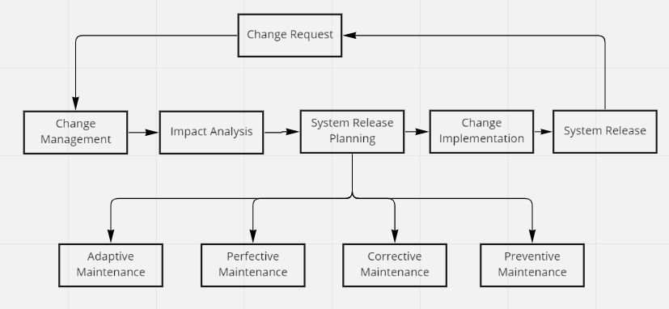

Slide 79
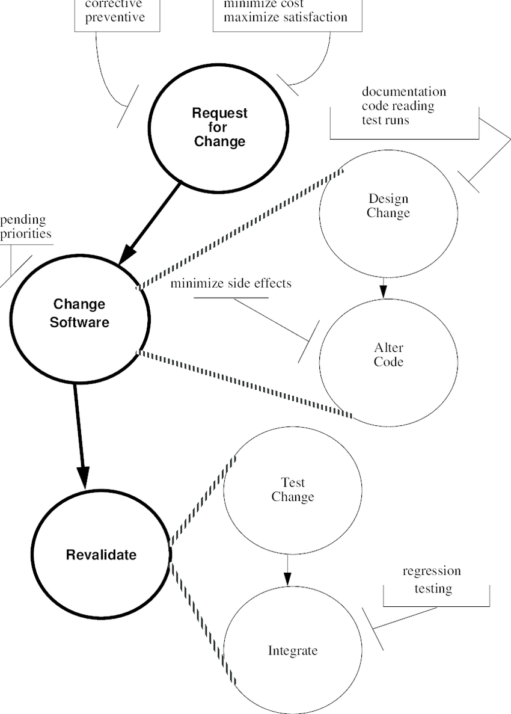
Software Maintenance Process Model

Slide 80
References
A Software Maintenance Process Model | Download Scientific Diagram (researchgate.net)
What is Preventive Maintenance? | Types, Examples, and Advantages of PM | FTMaintenance CMMS
What is Software Maintenance? Definition of Software Maintenance, Software Maintenance Meaning - The Economic Times (indiatimes.com)

Slide 81

Verification and Validation
Grandhi Aakarsh-191ADB108

Slide 82
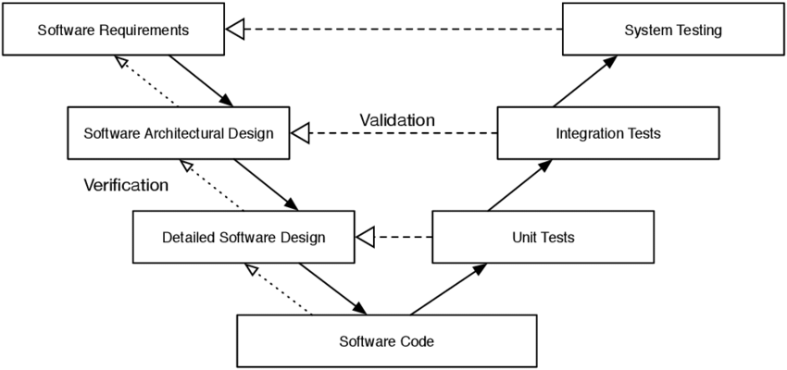
Definition
Validation is the process of determining whether a software product satisfies the requirements.
Verification is the process of ensuring that the software has been created based on given set of requirements.

Slide 83
Verification- Are you building it right?
Check whether the current phase conforms the previous phase.
Verification is usually done by developers.
Containment of errors are checked in every phase.
It involves methods like Inspections, Desk-Checking and Reviews etc.
Verification involves only Static and Dynamic Activities

Slide 84
Validation- Are we building the right product?
Checking if the final product has been built correctly or not by referring SRS documents.
Validation is usually done by testers.
The main goal is to ensure that the final product has no bugs or errors.
It involves Unit Testing and Integration Testing, Black Box Testing, White Box Testing.
Validation includes only dynamic activities.
Validation comes after Verification.
Verification and validation levels vary depending on the type of system and software development methodology.

Slide 85
Examples of Usages: Verification and Validation – User-Login Page
Let us consider a user login page which is present in almost in any mobile and web applications.
When we reach a login page, we can see the design, some issue with the instructions, clumsy webpage look etc. These are parts of verification.
Ensuring the execution of functionalities when the Sign-In/Sign-Up buttons are clicked, Performance of the functionalities etc comes into the validation part.

Slide 86
Flight Readiness Review(FRR) -NASA
The Last Milestone to be checked before launch.
What are the residual risks?
Initiate Countdown(T – X days Y Hours Z seconds)

Slide 87
FRR
Obtain certification that the flying activities may proceed safely and with an acceptable level of risks.
The system and supporting components have been verified as being appropriately changed and ready to fly.
The interfaces are indeed compatible, and work as expected.
The plane is set to take off.
The interfaces are tested and proven to be functioning.
Open items and waivers have been reviewed and determined to be acceptable.
All open and safety risk concerns are considered.

Slide 88
Mobile Application
Verification- Requirements verification, Design verification, Code verification.
Design verification- Verifying if the design produced at the end meets the user-defined design requirements in terms of layout, database models etc.
Validation- Performance and Functional Testing.
Function Testing- Installing, booking tickets/ordering food.
Performance Testing- Volume and Load Testing's.

Slide 89
Public Messenger(Group work)
Verification- Ensuring the design and requirements meets the SRS documentation given by customer.
Validation- Ensuring the buttons functionalities works well. Ensuring the hyperlinks works well, Ensuring the website doesn’t crash often. Ensure reporting enabled.

Slide 90
SOFTWARE PROJECT MANAGEMENT

Slide 91
Not every project needs to use every technique, but it is not clear which to use for particular project.
Sandra Slaughter, prof.Carnegie Mellon Universitys

Slide 92
1.
SPM 101
What is Software project management?

Slide 93
Technique and Tools
Define the scope of project
Customization of project with Stakeholder
Documentation of vision and scope
Creating the Project plan

Slide 94
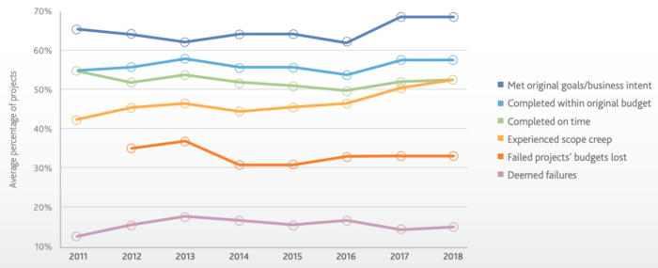
Listening the client
Planning
Realistic aim
Quality
Efficient method
Reference: Yaniv Beaudoin, Medium.com

Slide 95
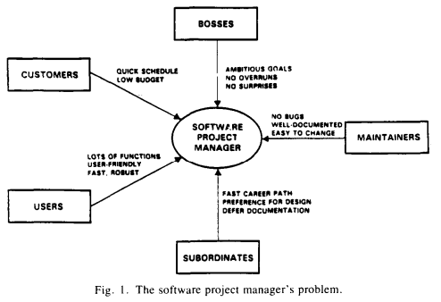
Ref: Barry W.Bohehm, and Rony Ross

Slide 96
2.
Process
What is development process flow?

Slide 97
ROADMAP of SPM
Implementation
Releasing
Requirement analysis
1
3
5
2
4
6
Design
Testing
Feedback
And
Maintaining

Slide 98
3.
Roles
What are the roles in SPM?

Slide 99
SPM Team
There are more than this roles, if the project is getting bigger constantly.
Product owner
Software manager
Team lead
Developer
QA Tester
UI & UX designer
Business Analysis

Slide 100
References
Applied Software project management, By Andrew Stellman, Jennifer Greene, 2005
Theory-W Software Project Management and Examples, Barry W.Boeh and Rony Ross, 1989
The Influence of Agile Methodology (Scrum) on Software Project Management, Faisal Hayat, Ammar Ur Rehman, Khwaja Sarmad Arif, Kanwal Wahab, Muhammad Abbas, 2019
Software Project Management in Practice, Pankaj Jalote, 2005
Quality Software Project Management, By Robert T. Futrell, Donald F. Shafer, Linda Shafer,2002
Software Project Management Practices : Failure Versus Success, Capers Jones, 2004s

Slide 101
Questions session
Thank you for attention!

